Slide 1


Volleyball Training Manager
Team Spike
By: Nj , Lara , Simba , Anton, Halo

Slide 2

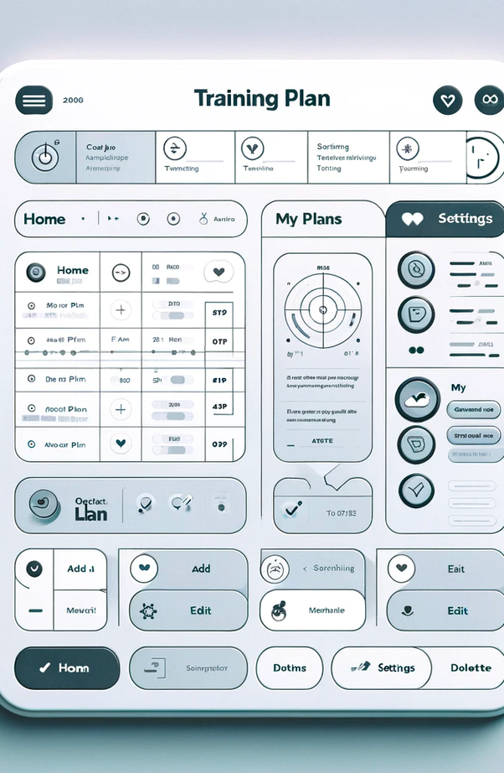
WHAT TO KNOW ABOUT US & OUR PROJECT?
About us
Our client is the women’s volleyball head coach, Will Condon
Our project entails creating an online database and tool for creating practice plans.
LEARN MORE

Slide 3
Overview
Our client is looking for a simple yet effective searchable database of drills
Currently Coach Condon is using ………………..
Stakeholders currently are
Coach Will
The university
The players themselves

Slide 4
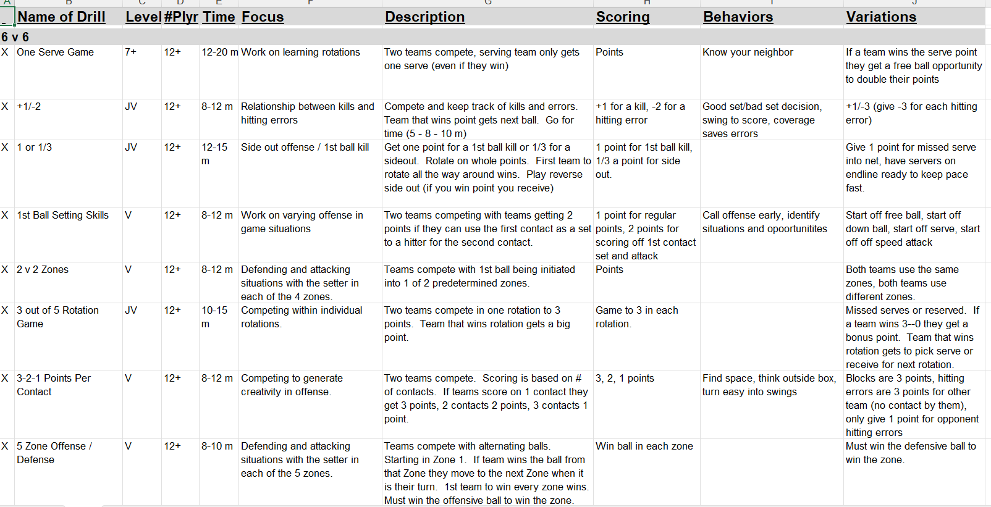
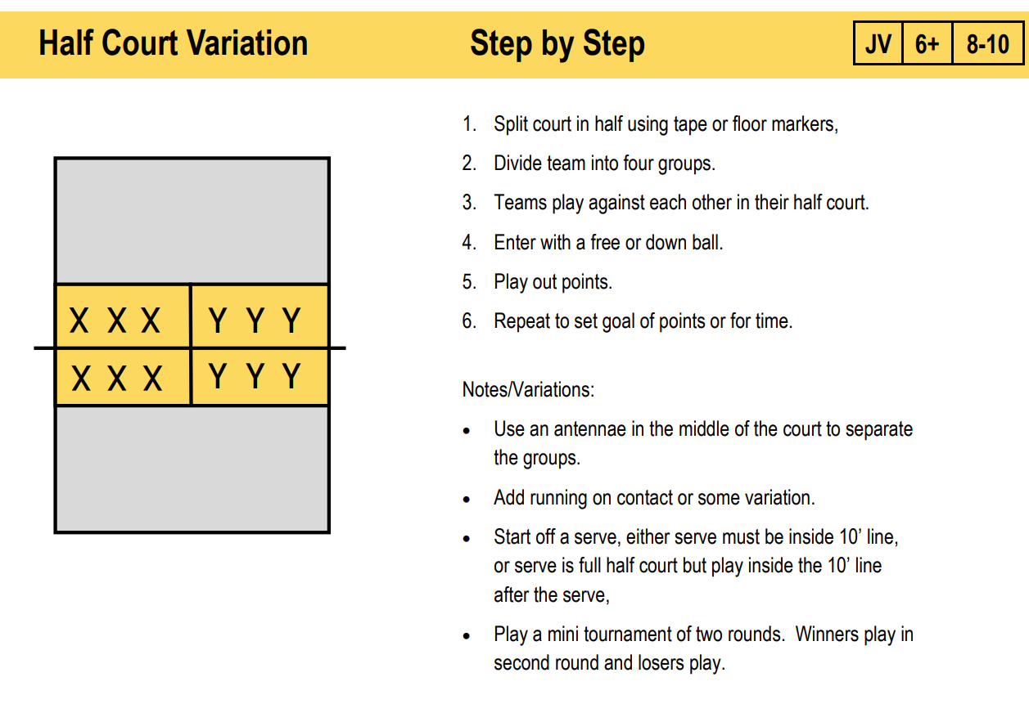
Current Method
Using excel to show the info of drills and copies and paste the drill chosen and makes a pdf which will be sent out to the players

Slide 5
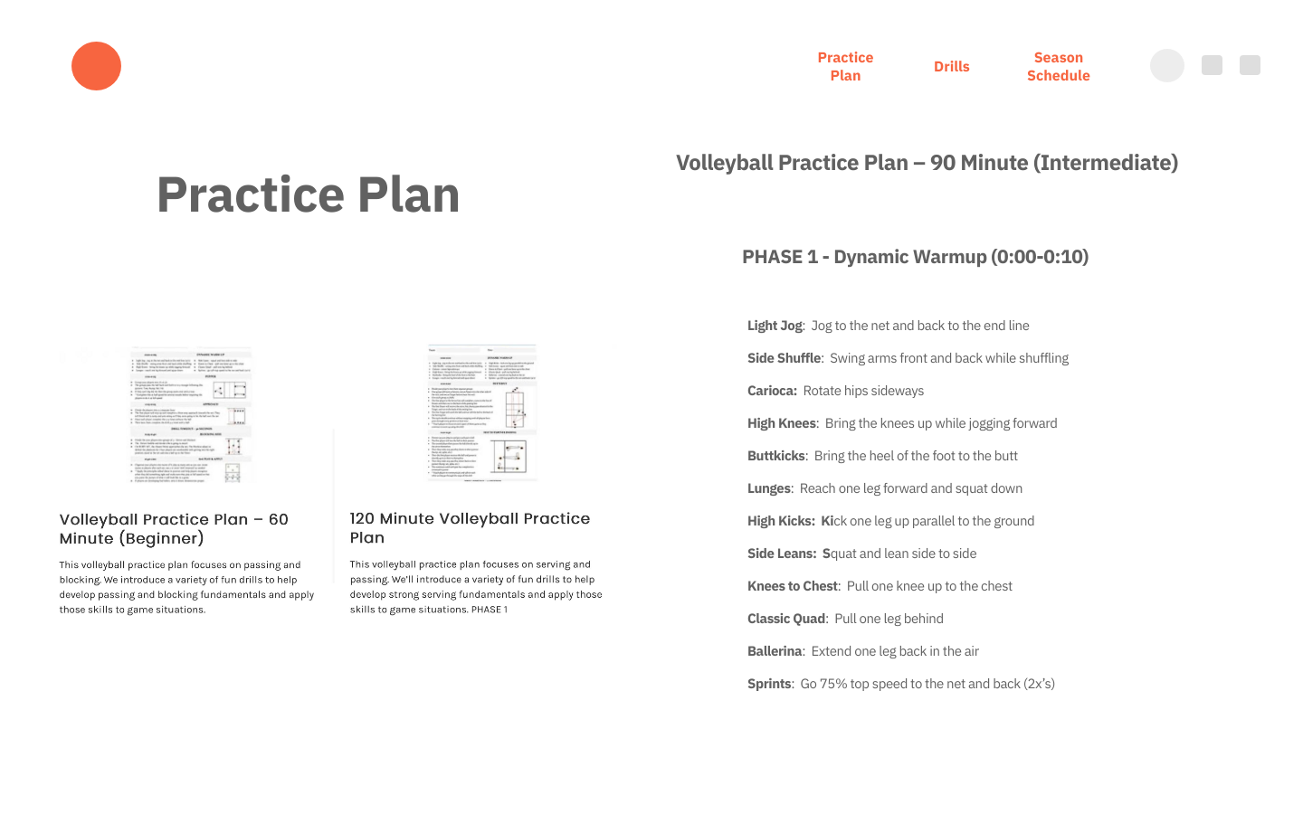
Proposed GUI
Since our client mentioned online The portal is going to be website based allowing Coach to access this whenever she needs to

Slide 6
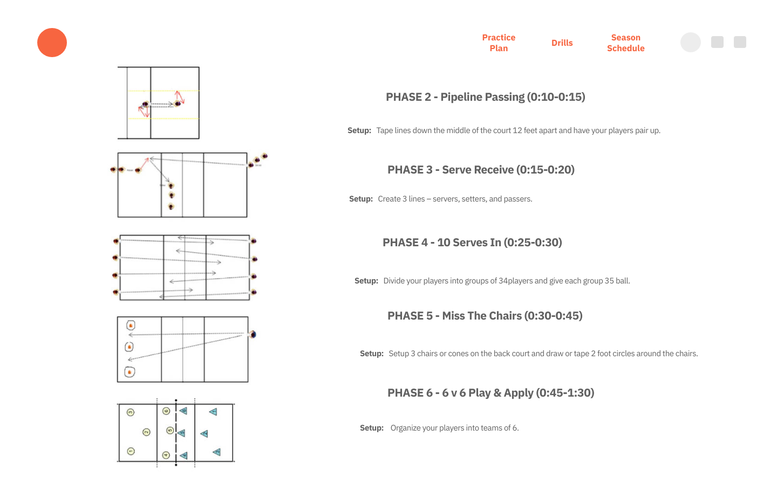
BreakDown
Each drill is different and has its own setup , therefore through the use of keywords such as number of players
Time for the training will determine what drill to be done
This will allow our users to create accessing the data base (Drill Matix) and share through the desired platform either email or mobile

Slide 7
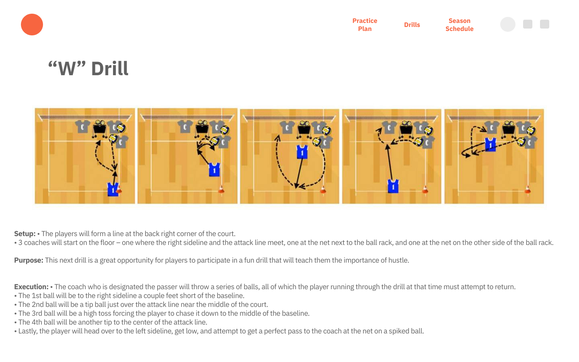
DISPLAY
Once the drill are chosen and plan is put into place, it can become sharable as one pdf

Slide 8
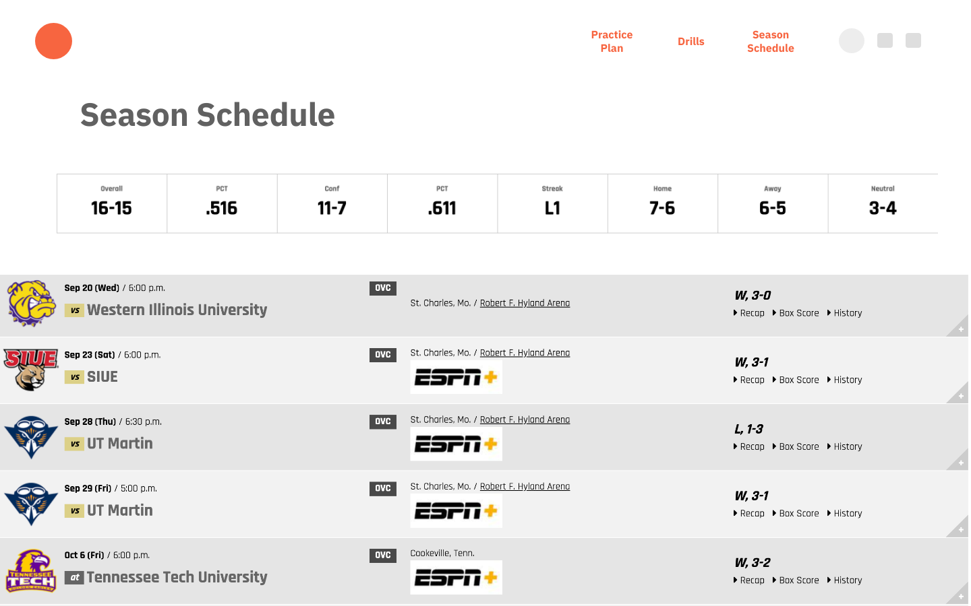
Objective
Give Coach a chance to create schedule ahead of time
Players to have flexible training and not have to wait on coach
Have a user-friendly website save time and make planning easier

Slide 9

Thank you

